Slide 1



Globetrotters
PIORENCE ABAR
JAKE JABBORA
MARK LUNA
CHRISTOPHER PAKOSTA
ANDRES MARTINEZ PAZ
BRIAN PHAM
LEON TRAN
KEVIN WARNER

Slide 2



Education + Technology

Slide 3
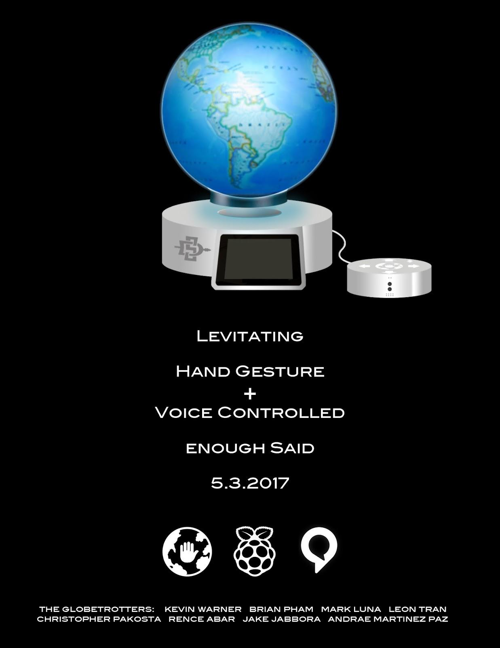
Trotter

Slide 4

Vision

Slide 5
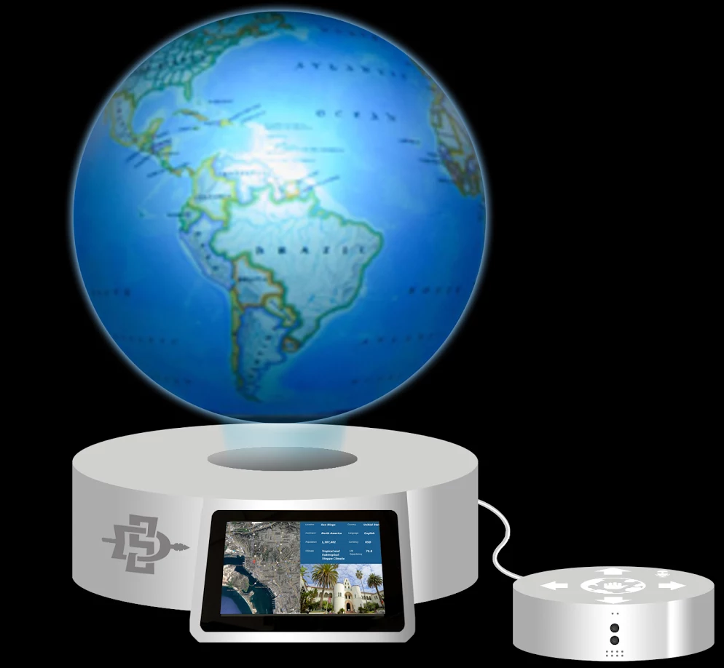
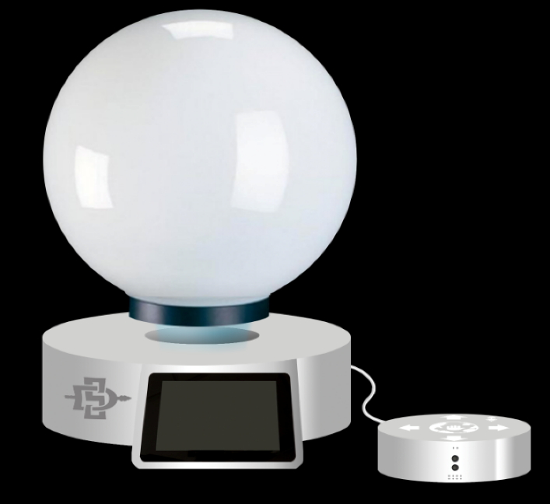


Our Proposal
Physical
Virtual
OR

Slide 6
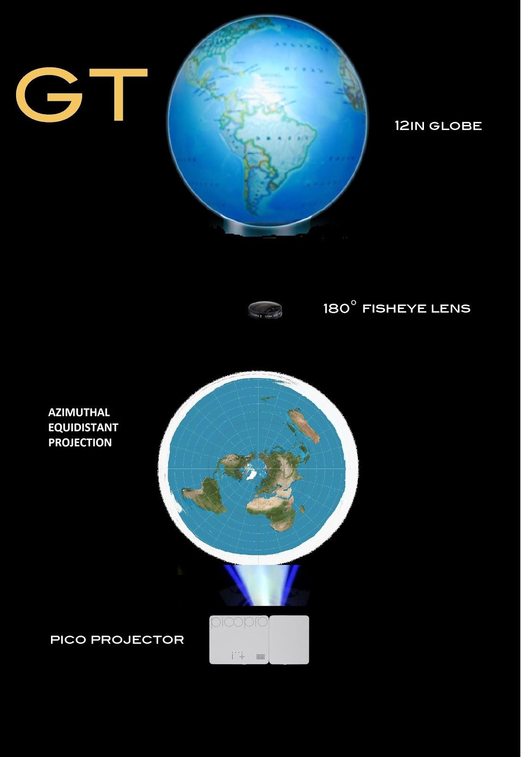
Virtual Globe

Slide 7

Vision

Slide 8
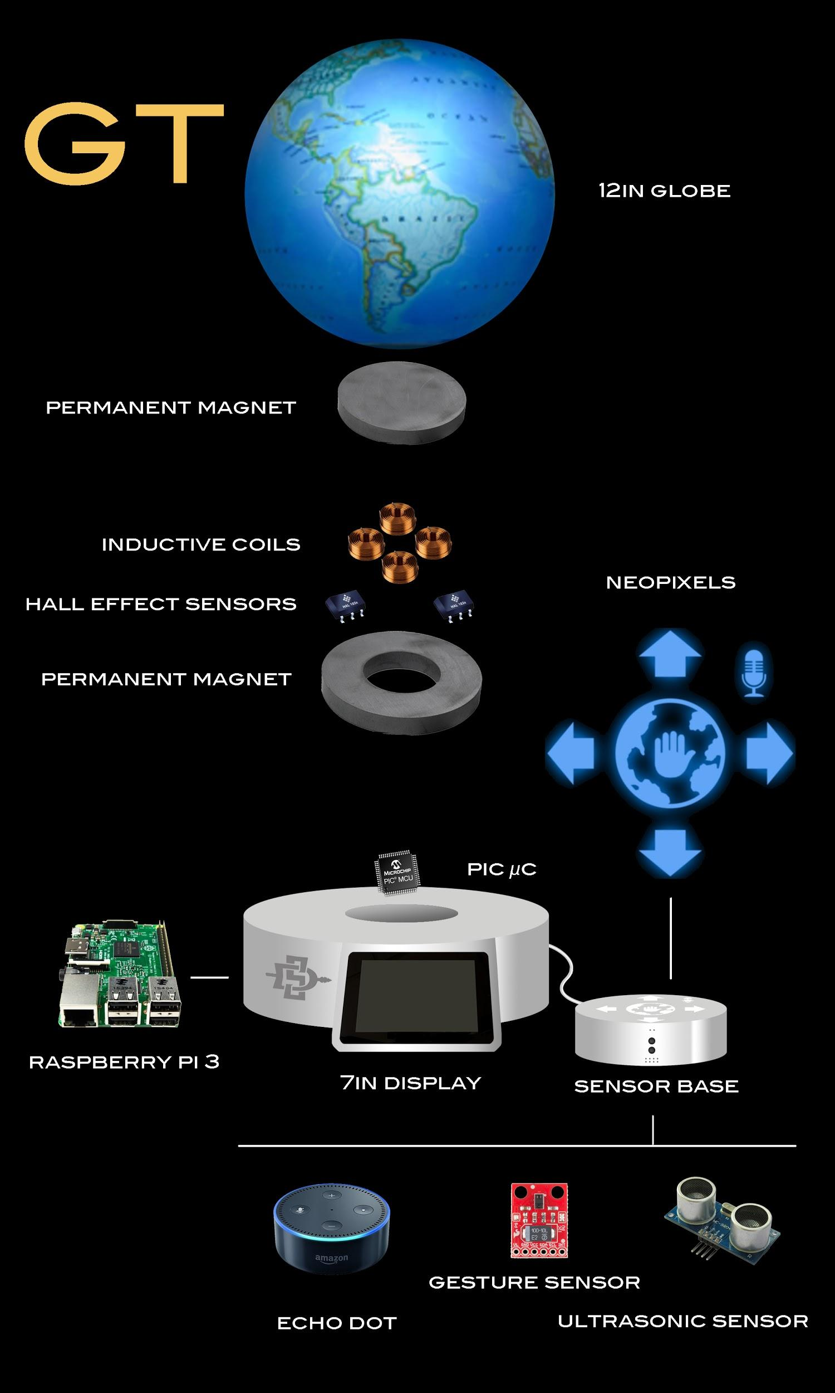
Levitation

Slide 9
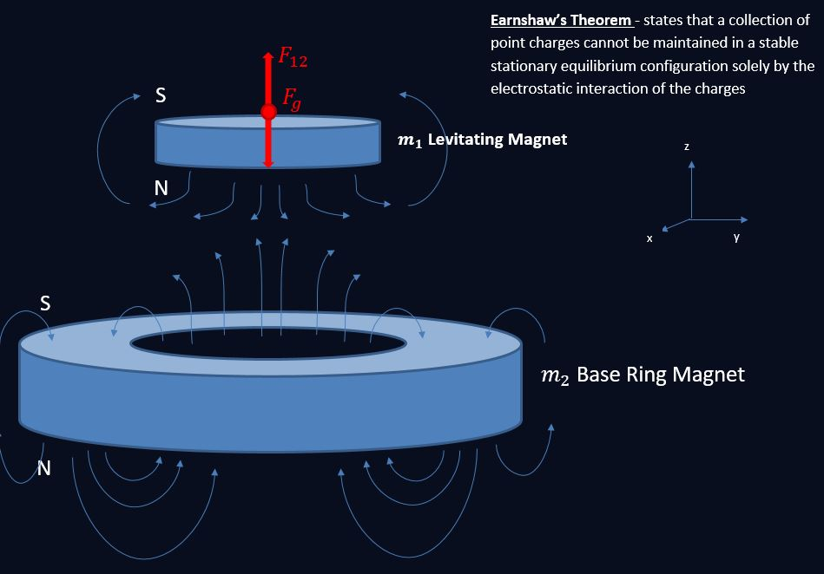
Magnetic Forces

Slide 10
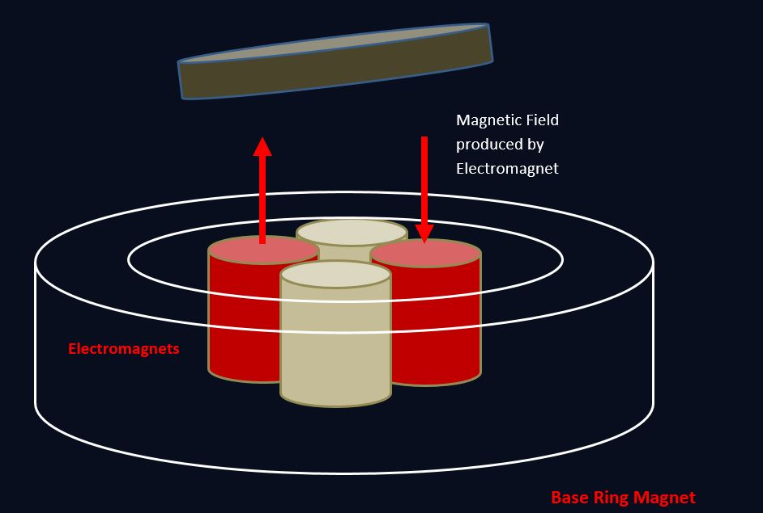
Electromagnet’s Force
N
W
E
S
Notes:
As Chris stated, in order to maintain the stability of the magnet at its equilibrium point we must implement a sort of feedback controls system. With the help of our hand-wound coils we are able to do just that. As you can see from the figure, this is how our coils are positioned on the inside of the ring magnet in our base. The coils are connected in series, the red with the red, white with the white.
Now it’s a common misconception but the coils don’t do any of the heavy lifting, they are just there to provide stability by pushing/pulling
This is possible because they are all coiled same direction, current flows up through one down the other, giving us the ability to change the position of the levitating magnet.
For example, if the magnet starts falling towards the west end, the current will flow west to east, inducing a pushing force to center the magnet. If the magnet falls towards the east end then the same thing occurs.
However, to determine the actual position of the levitating magnet we must use
Position – determined by the Hall Effect sensors, detect the change in magnetic fields and outputs that as a voltage
Exactly how we determine the positioning and control the coils is where our PIC24 Microcontroller comes in, to talk about that here’s mark

Slide 11
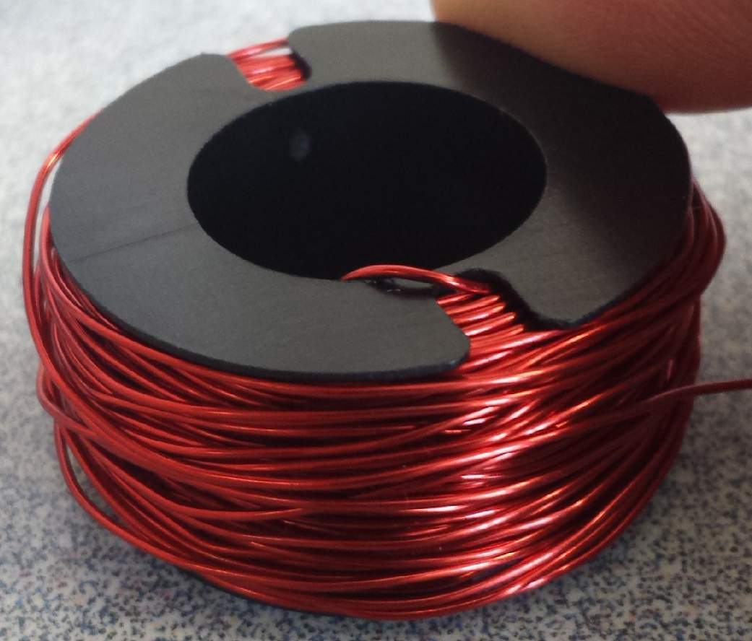
Electromagnet’s Force
N
W
E
S
Notes:
As Chris stated, in order to maintain the stability of the magnet at its equilibrium point we must implement a sort of feedback controls system. With the help of our hand-wound coils we are able to do just that. As you can see from the figure, this is how our coils are positioned on the inside of the ring magnet in our base. The coils are connected in series, the red with the red, white with the white.
Now it’s a common misconception but the coils don’t do any of the heavy lifting, they are just there to provide stability by pushing/pulling
This is possible because they are all coiled same direction, current flows up through one down the other, giving us the ability to change the position of the levitating magnet.
For example, if the magnet starts falling towards the west end, the current will flow west to east, inducing a pushing force to center the magnet. If the magnet falls towards the east end then the same thing occurs.
However, to determine the actual position of the levitating magnet we must use
Position – determined by the Hall Effect sensors, detect the change in magnetic fields and outputs that as a voltage
Exactly how we determine the positioning and control the coils is where our PIC24 Microcontroller comes in, to talk about that here’s mark

Slide 12
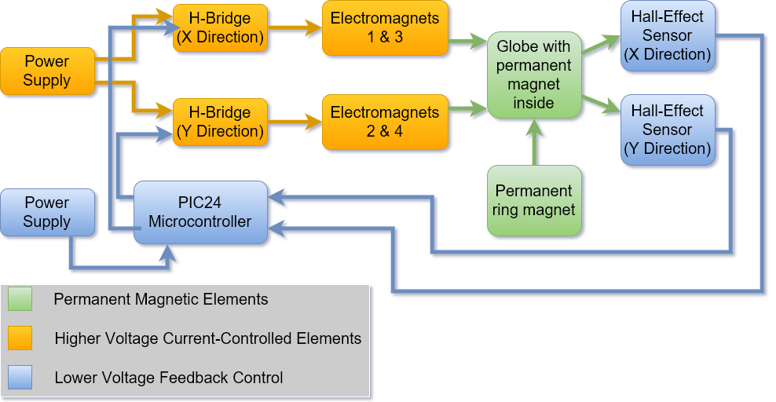
Hardware Block Diagram

Slide 13
Hardware Block Diagram

Slide 14
Hardware Block Diagram

Slide 15
Hardware Block Diagram

Slide 16
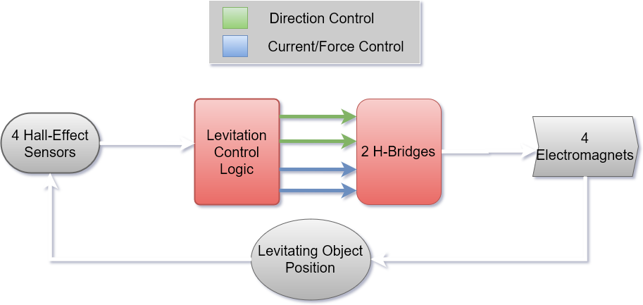
PID Control
Notes:
Microcontroller - proportional-integral-derivative controller to keep levitating object in the center
2 H-Bridges - control direction and amount of current through 4 electromagnets
Electromagnets will change position of levitating globe
As the globe moves, 4 hall-effect sensors detect position of the globe
This information is sent back to microcontroller which manipulates data with PID algorithm
H-Bridges are once again controlled based on result of algorithm

Slide 17
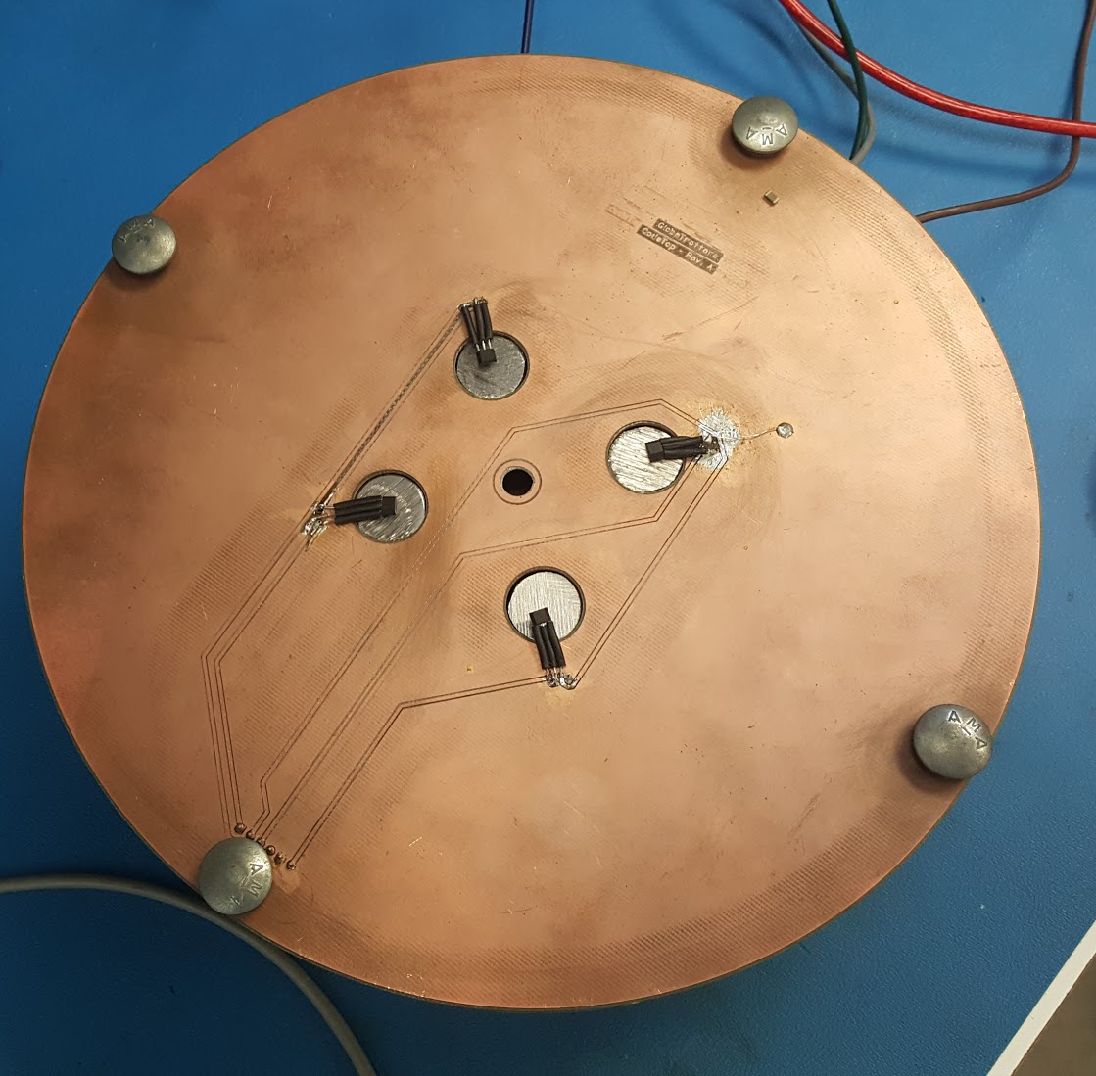
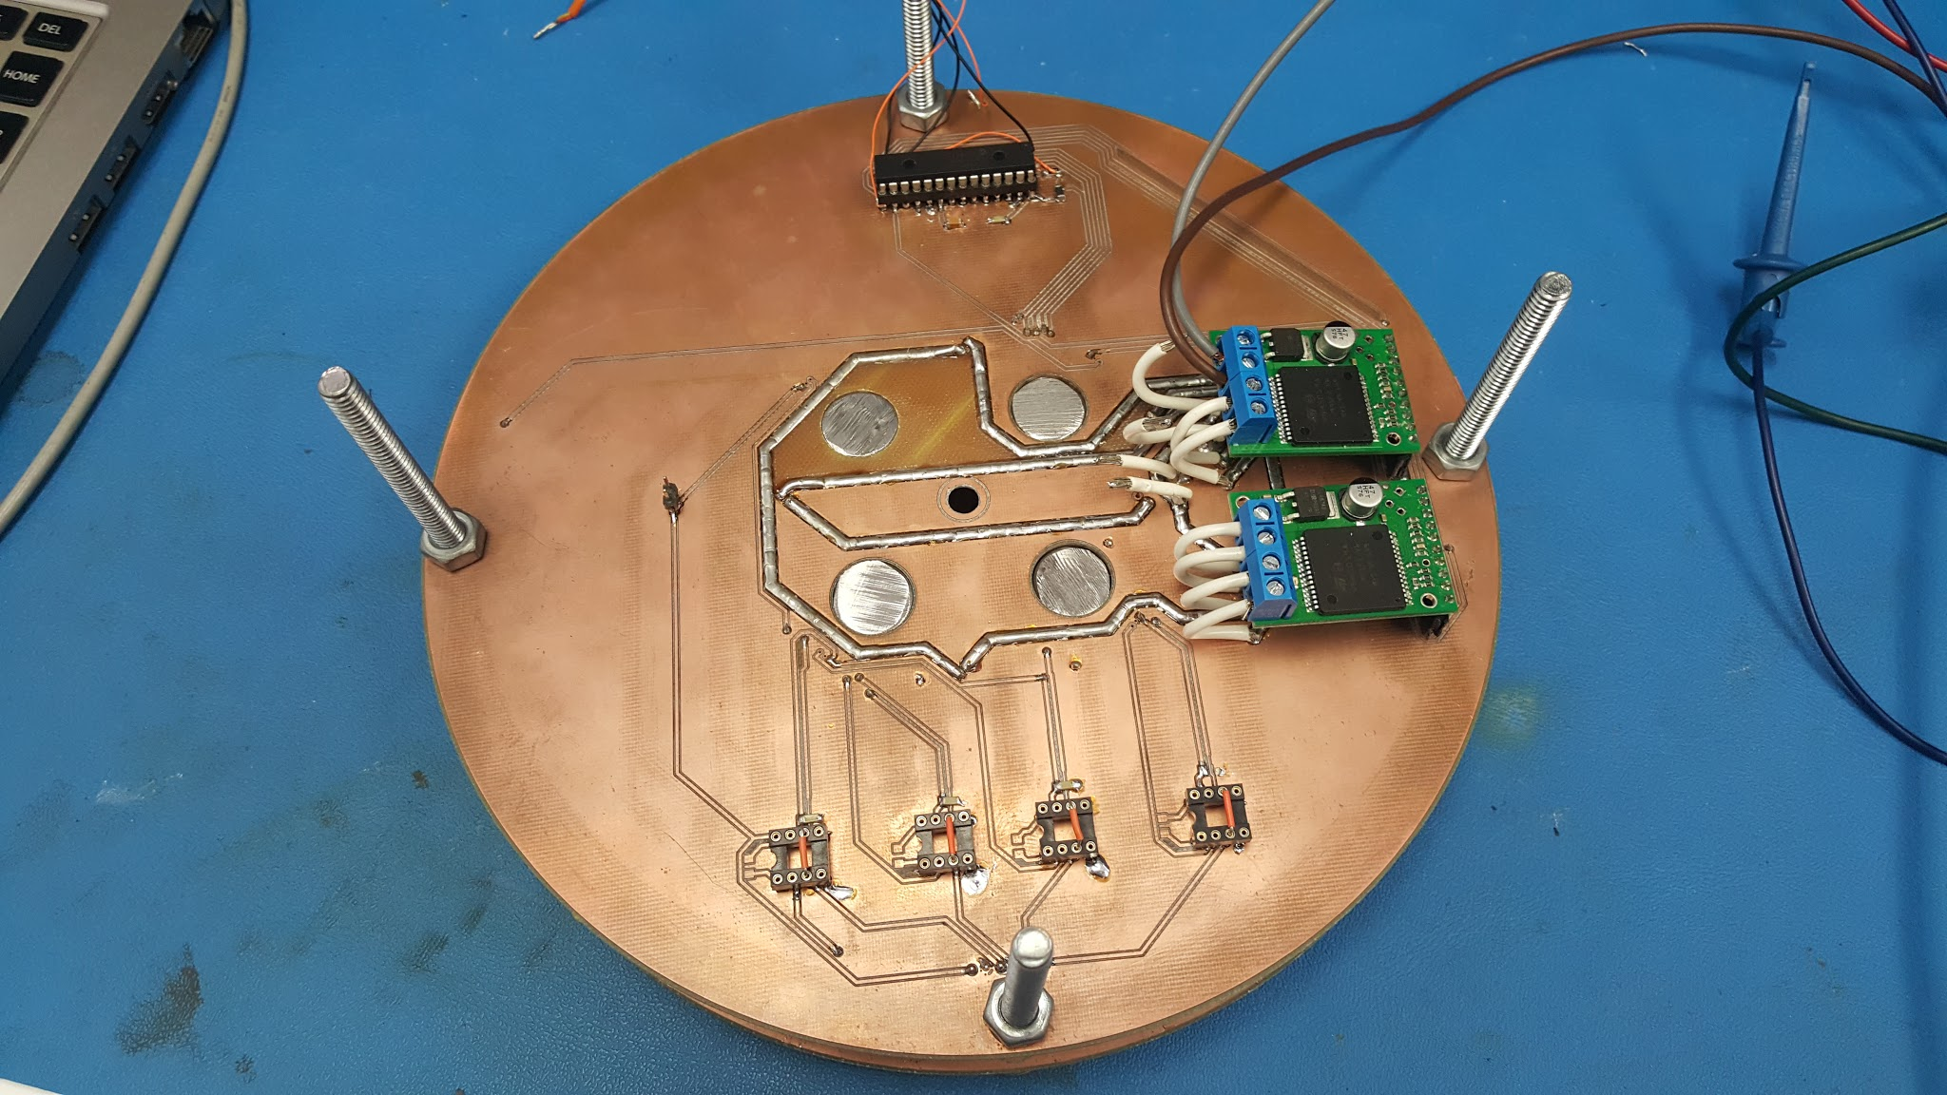
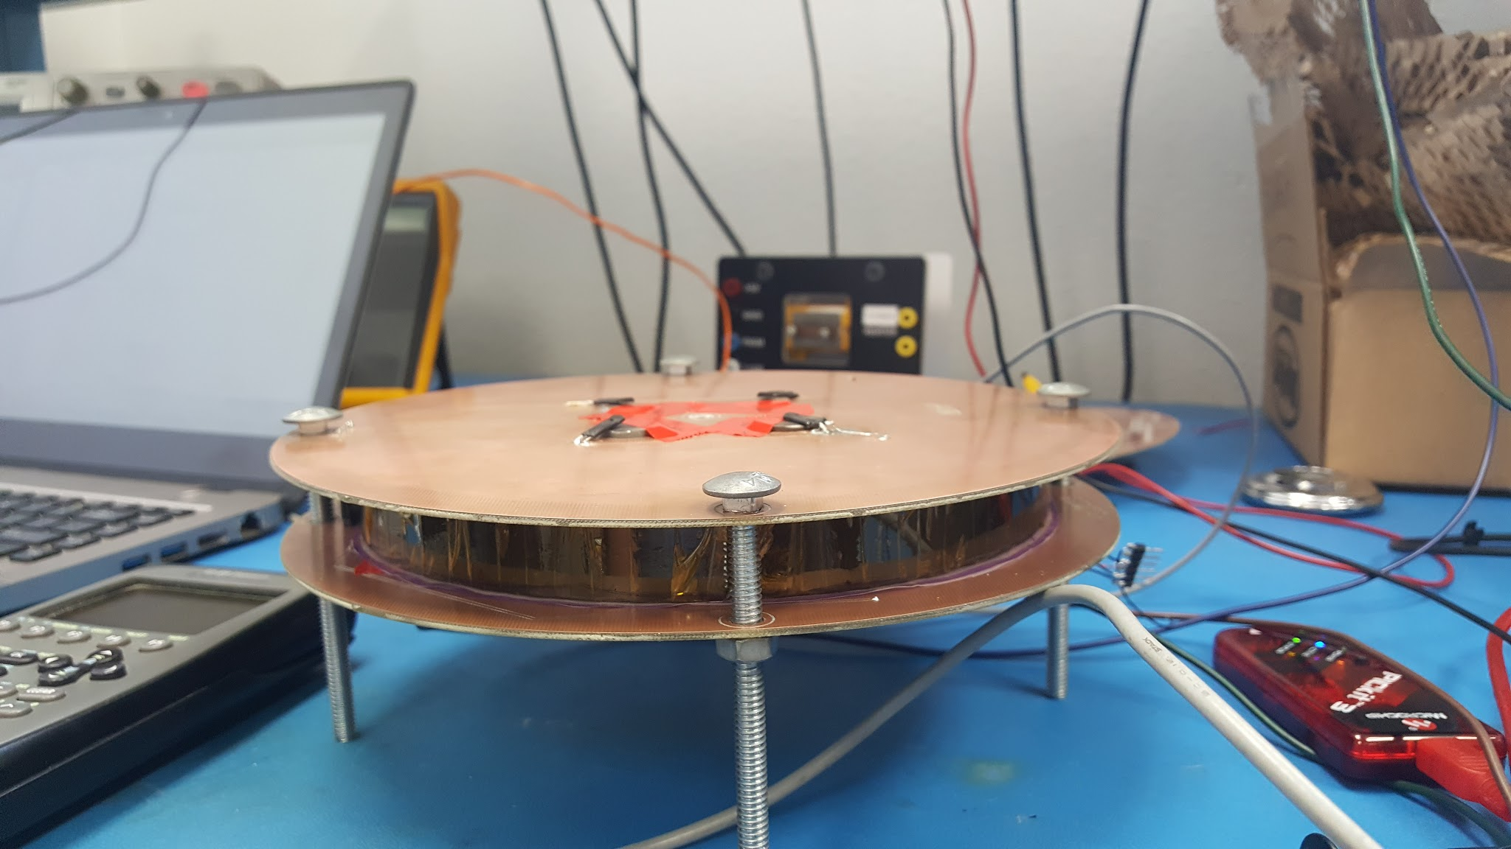
Levitation Base
H-Bridge
Hall Effects
Top
Bottom
Ring Magnet
Side

Slide 18

Virtual Globe

Slide 19
Breakdown

Slide 20
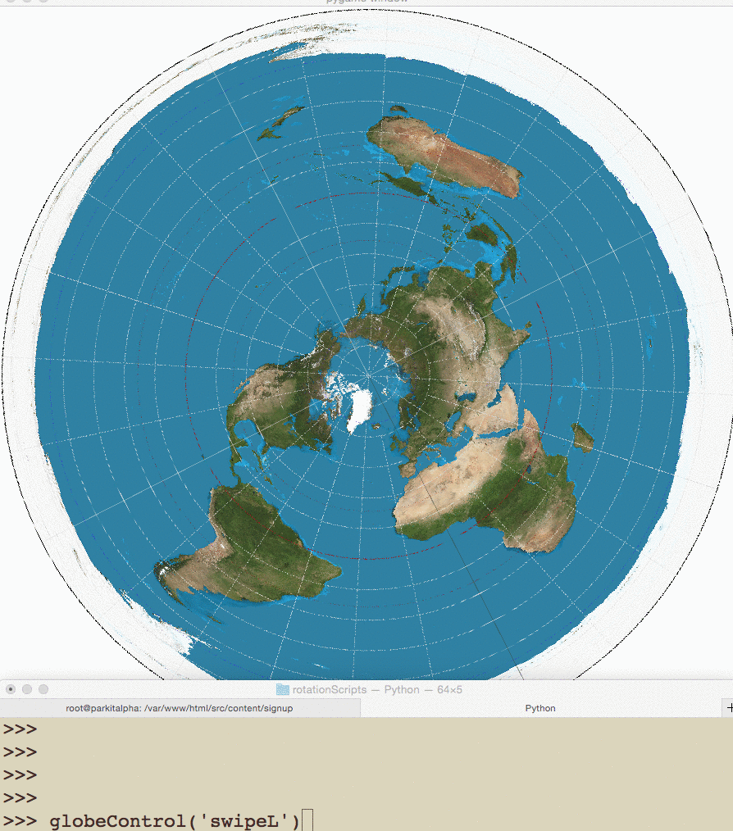
Rotation

Slide 21

Graphical Interface

Slide 22

Graphical Interface

Slide 23
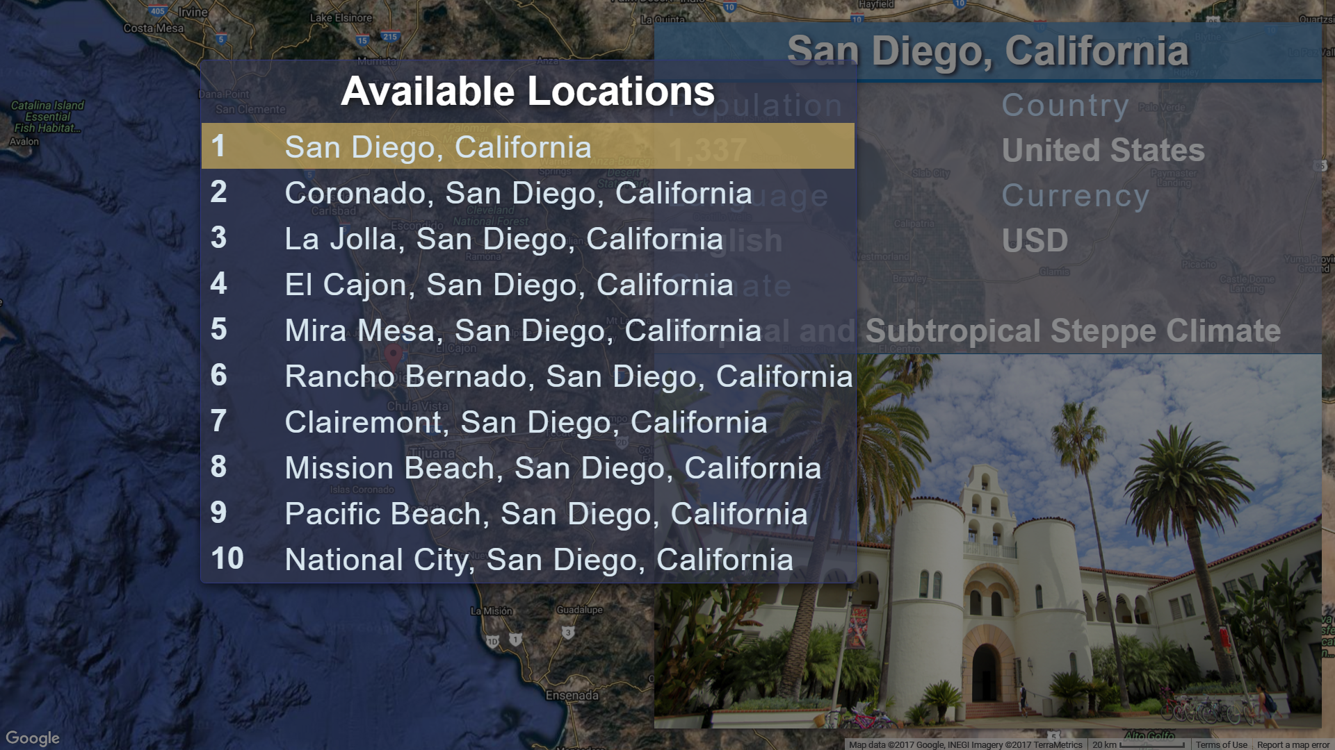
Graphical Interface
GUI

Slide 24
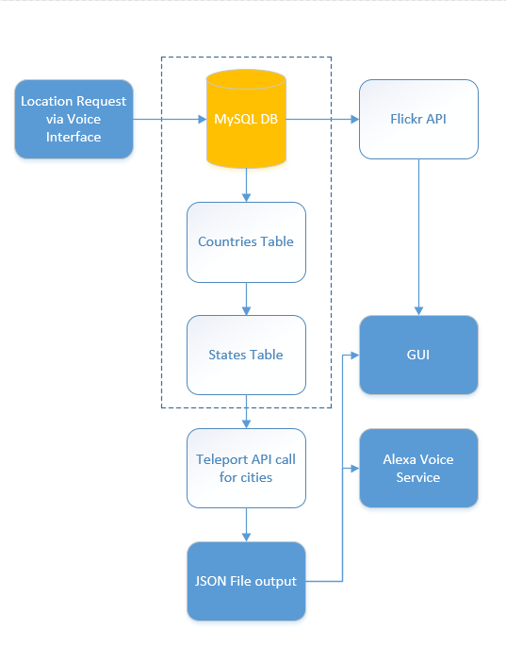
Backend Flowchart

Slide 25


Voice & Gesture Interfaces

Slide 26


Gesture Interface

Slide 27
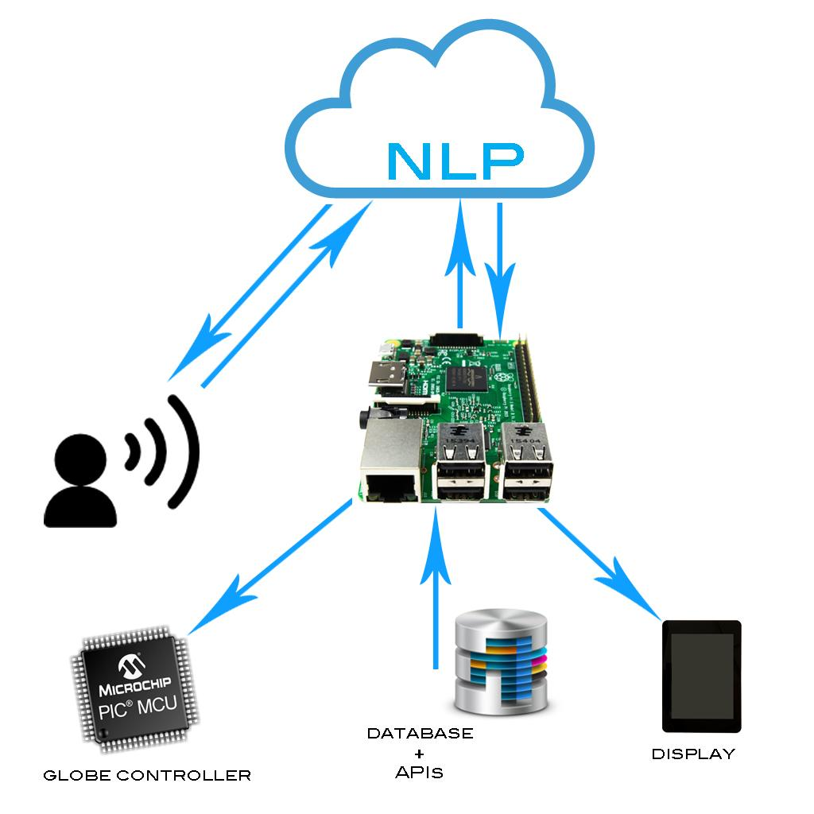
Voice Recognition

Slide 28
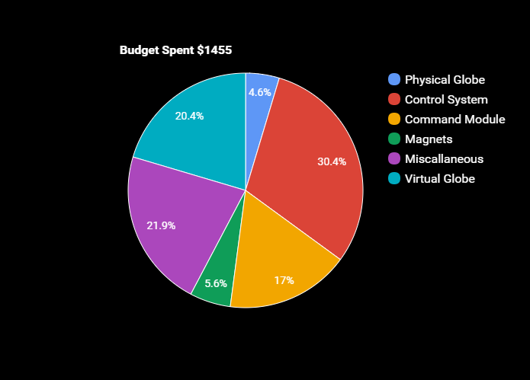
Starting Budget | $1500
Virtual Globe | $296.84
Physical Globe | $67.54
Command Module | $247.88
Control System | $442.34
Magnets | $81.98
Miscellaneous | $318.41
Total | $1454.99
Notes:
Started with 1500
two solutions
pursued both
strong control system

Slide 29
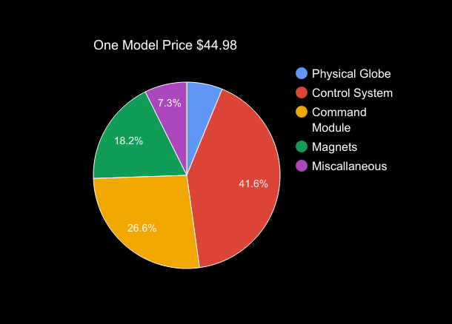
Physical Globe | $2.79
Command Module | $11.98
Control System | $18.27
Magnets | $8.19
Miscellaneous | $3.30
Total | $44.98
**Price based on 1,000 units

Slide 30
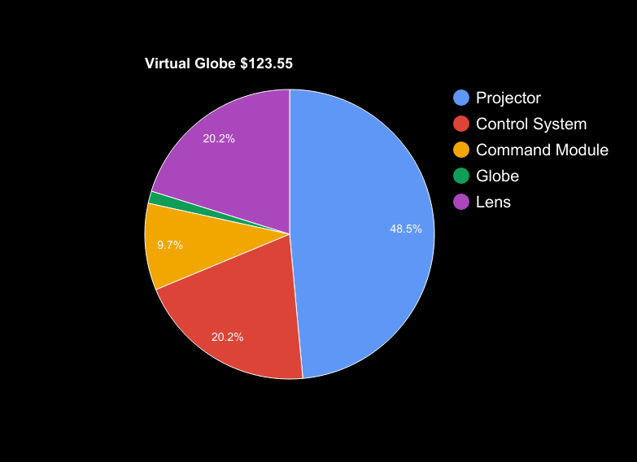
Virtual Globe | $1.69
Control System | $24.95
Projector | $59.98
Lens | $24.95
Command Module | $11.98
Total | $123.55
**Price based on 1,000 units

Slide 31


Milestones
Deadline | Task | Status
02/21/17 | Finish Research
03/16/17 | Voice Control Integrated with GUI
03/31/17 | Gesture Control Integrated with GUI
04/06/17 | Design & Construct Gesture Base Model
04/17/17 | PCB Designed and Tested
04/28/17 | Controls System Tested
04/30/17 | Levitate the Globe

Slide 32
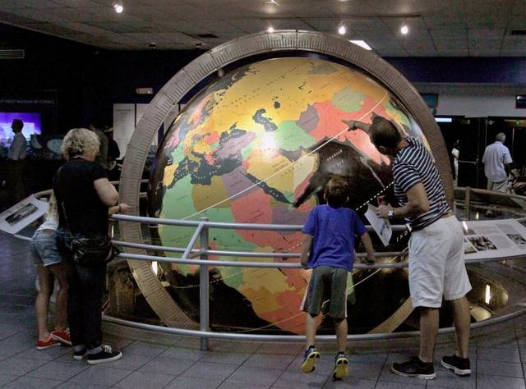
The Future of Trotter

Slide 33
Thank You!

